Slide 1
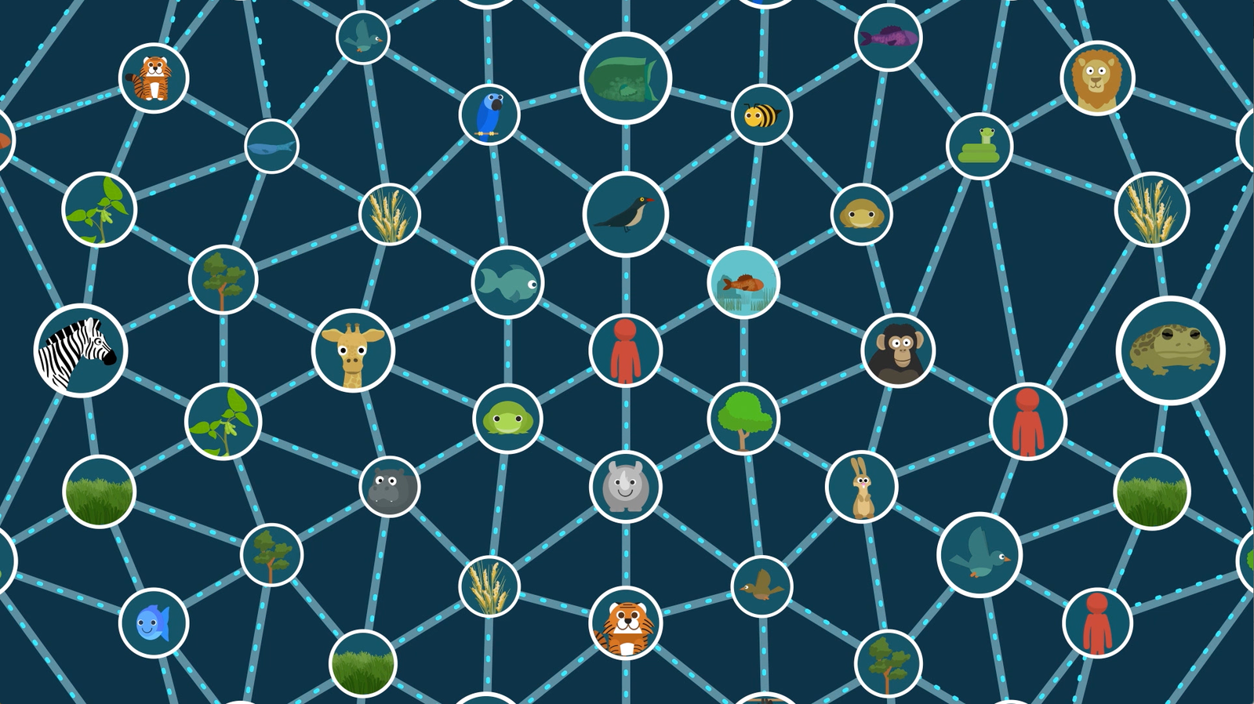

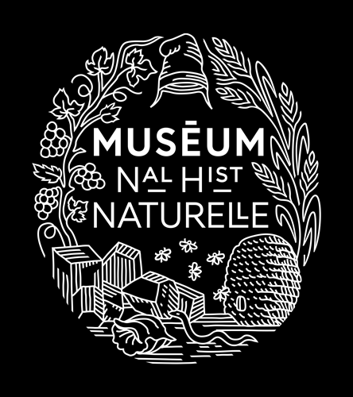

(Inter)dependency and resilience in the living world:
An evolutionary biology perspective
Dr. Eric Bapteste

Slide 2
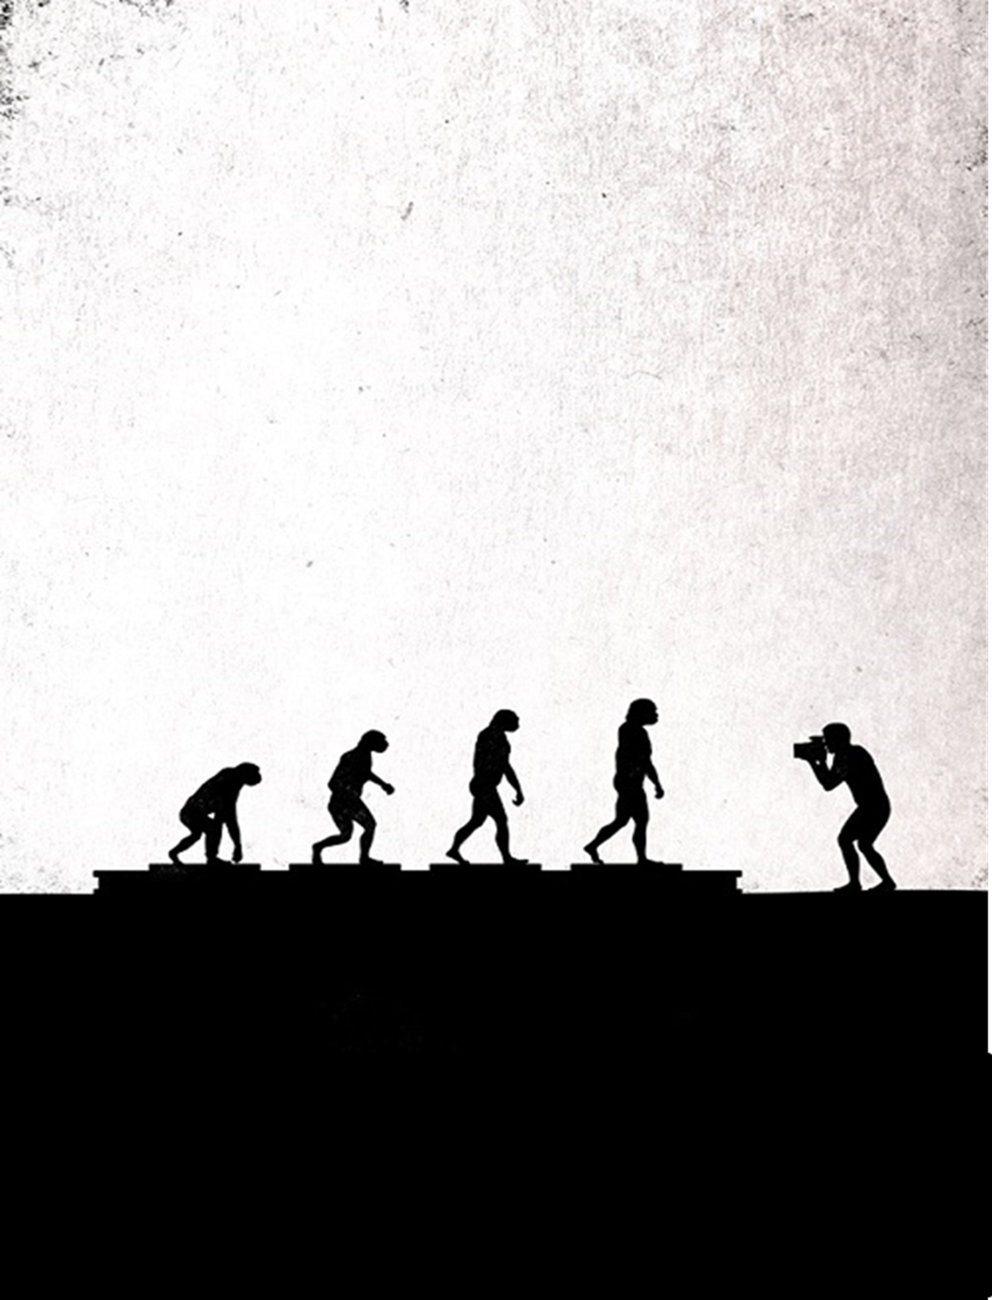
I am an evolutionary biologist.
An evolutionary biologist
Evolutionary biology tries to explain the history and diversity of life.
what evolutionary biologist do : explaining the origin of diversity, of traits, by understanding processes of stases and processes of change

Slide 3
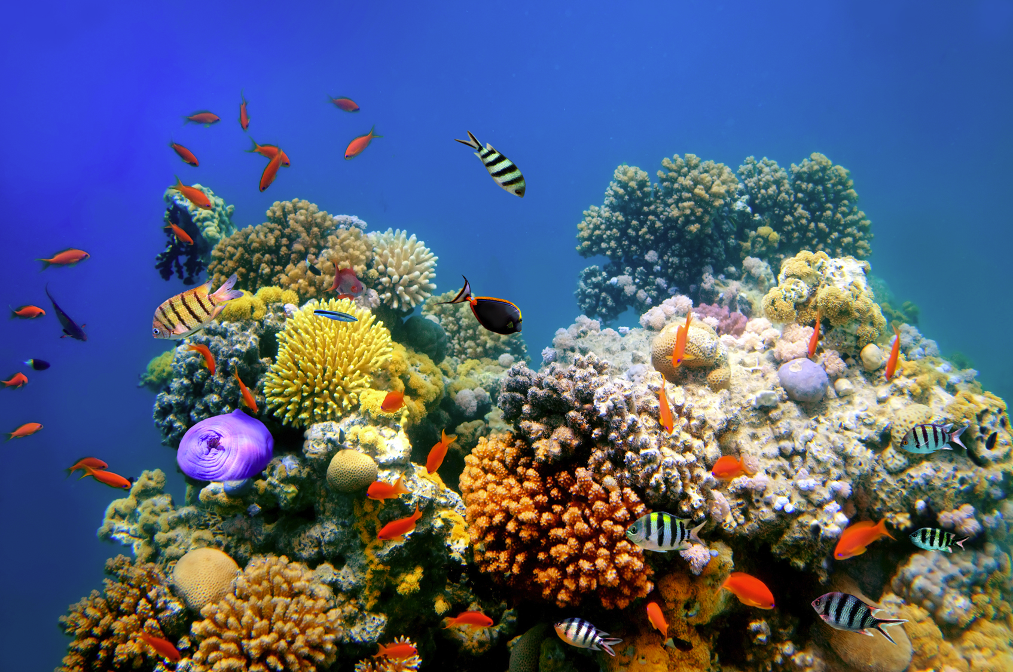
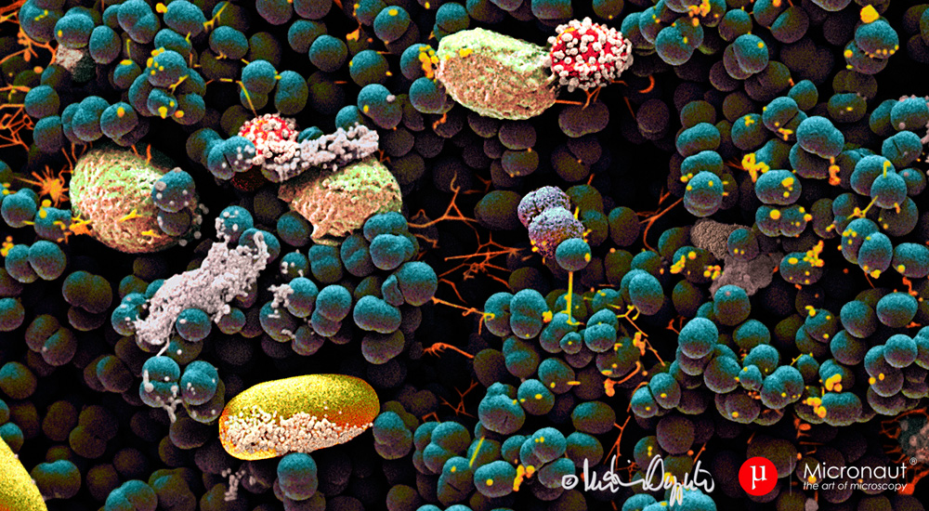
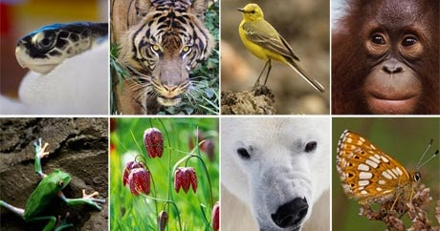
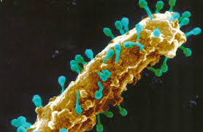
What processes produced and sustained the diversity of life froms, over time?
I investigate these issues using networks, focusing on interactions.
http://robdunnlab.com/projects/belly-button-biodiversity/
Notes:
As you all know

Slide 4
Aim of this talk
A (long but) simple argument to show that evolutionary biology
may have something relevant and new to say about dependencies and interdepencies in the biological world.

Slide 5
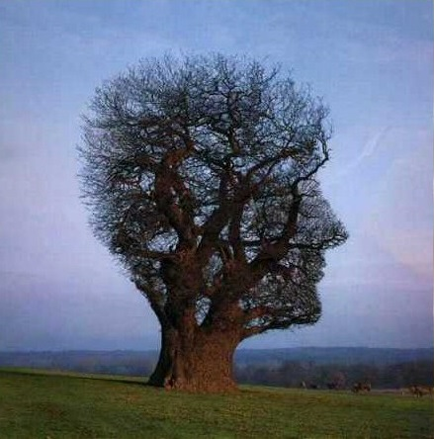
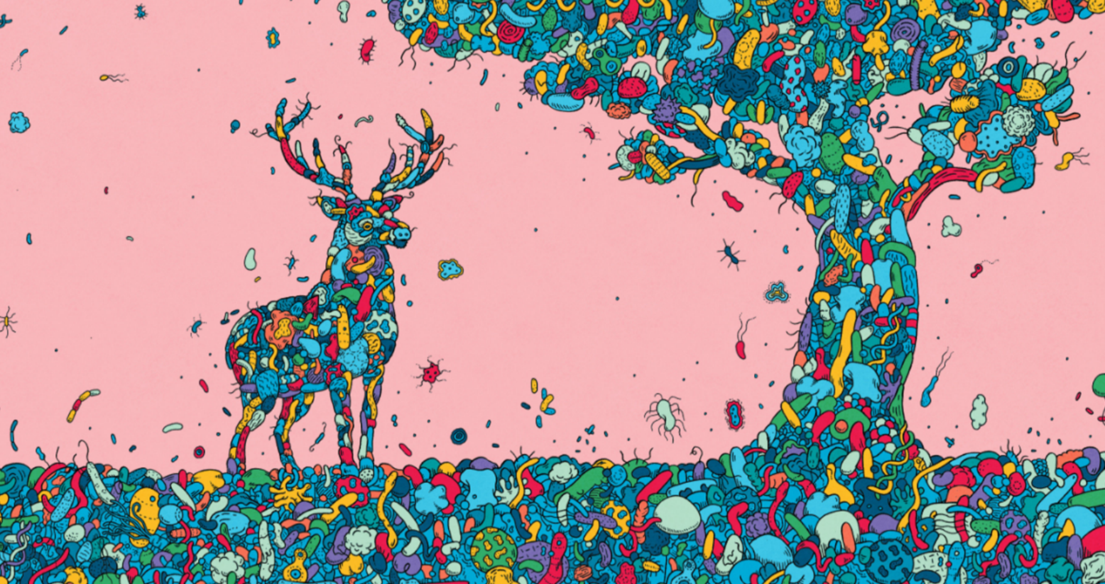
Rough plan of the talk
Traditionally, evolutionary biology focuses on lineages
However, a different focus - on interactions- appears very relevant
A focus on interactions expands evolutionary explanations
with potential to better track dependencies/interdependencies in the living world

Slide 6
Evolutionary biology traditionally describes the history of lineages.

Slide 7
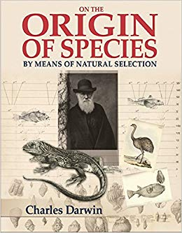
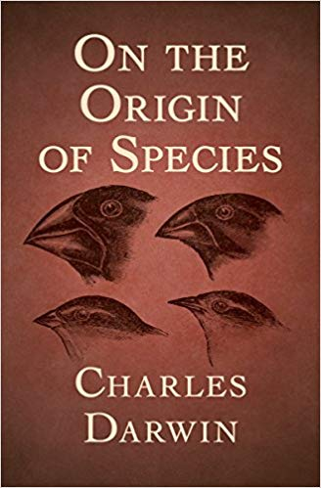
1859
(1809-1882)

Slide 8
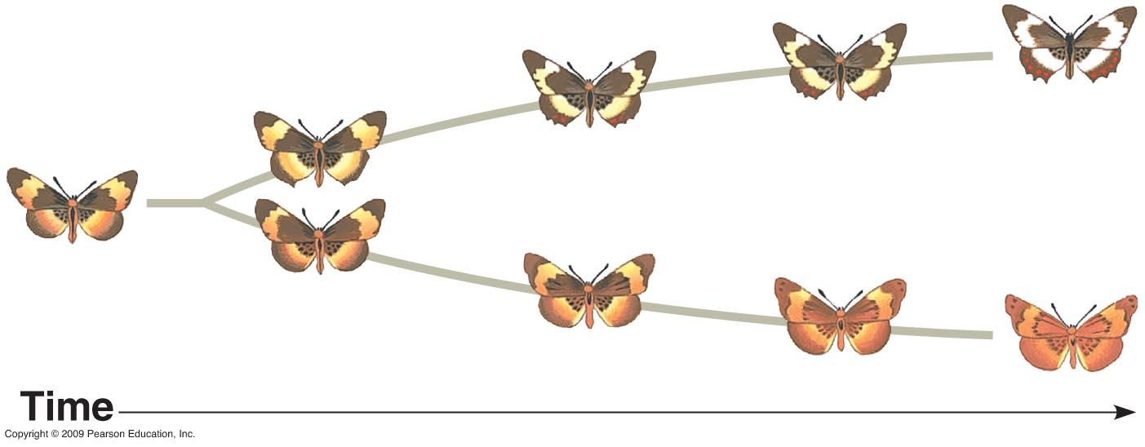
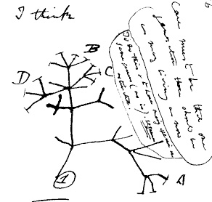
This book presented:
- 1 process: descent with modification
- 3 conditions for its realization (variation, inheritance, differential fitness)
- 2 bold hypotheses: natural selection + tree of life

Slide 9

Therefore, classic evolutionary biology is centered on natural selection,
to explain the survival of the fittest
- the production of (advantageous) variation
the transmission of that (advantageous) variation to offsprings
An increased ability of organisms with advantageous variations to produce more offsprings,
So that, over generations, the frequency of more fit organisms would increase in a population.

Slide 10
The bottom line is that
« genes mutate, organism change and population or species evolve».

Slide 11
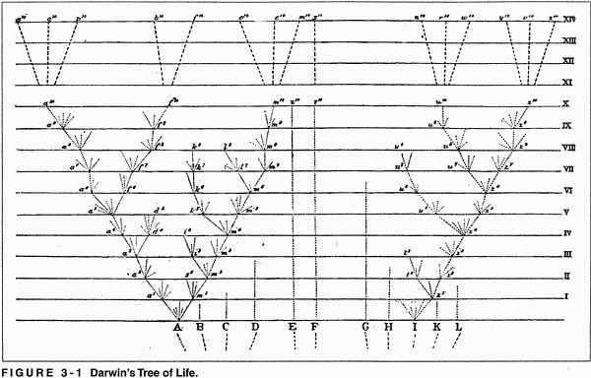
Un processus évolutif central: la descendance avec modification
Furthermore, Darwin extrapolated this logic to explain the evolution of all organismal lineages on Earth.
Present
Extant species
Past lineages
Past life forms
Past
C. Darwin 1859

Slide 12
There are indeed many good reasons to use a tree model to study the biological world and its evolution.

Slide 13
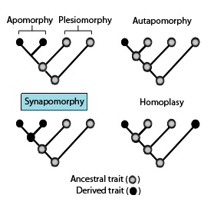
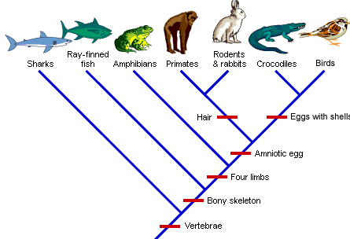
It offers a popular way to classify living beingss and to infer shared derived traits inherited from an ancestor.
s

Slide 14
But this tree-based picture should not hide another biological observation:
there are interactions everywhere in the biological world.

Slide 15
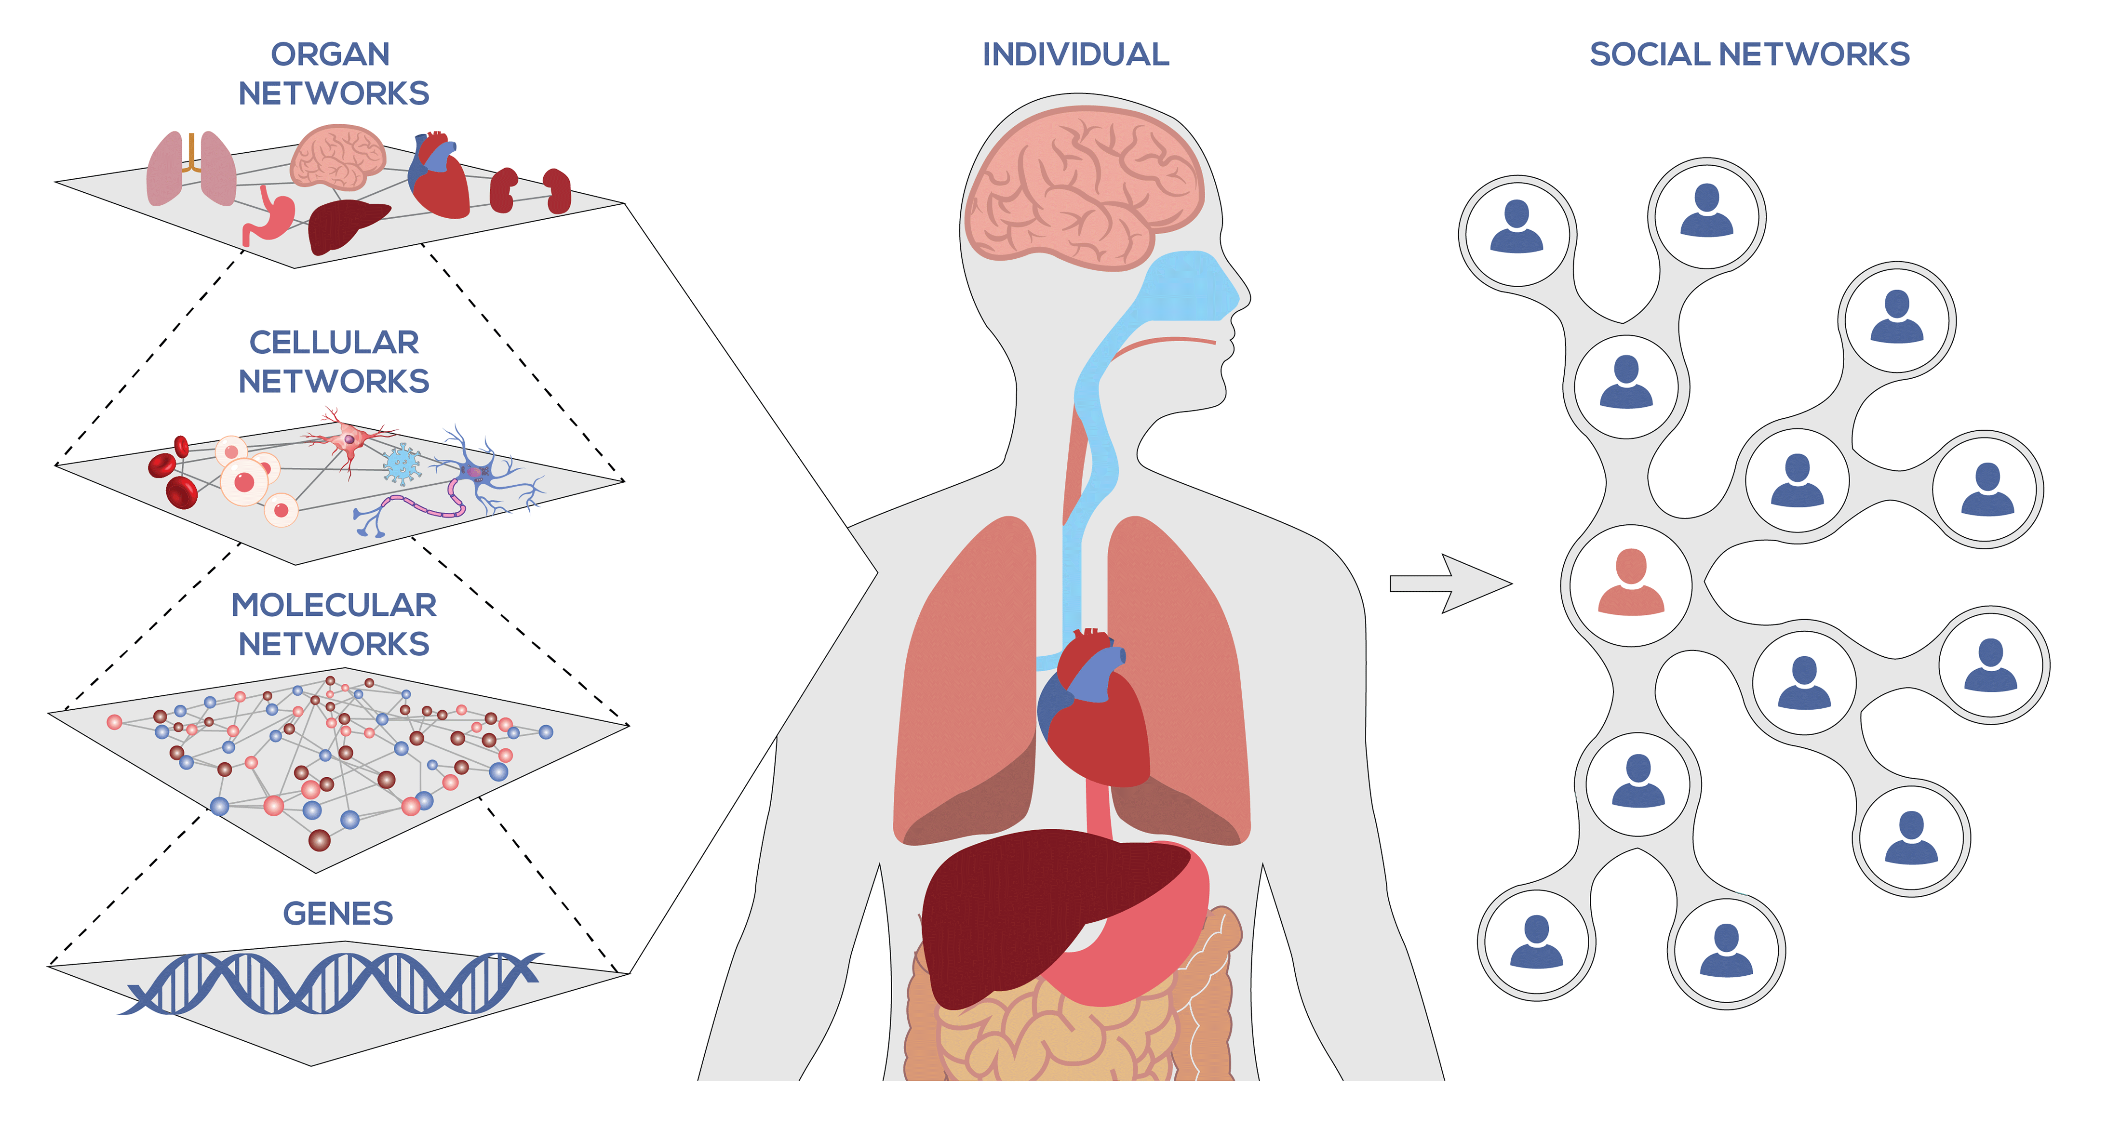
We are composed of networks and part of networks.
https://systemsbiology.org/

Slide 16
Importantly, these networks introduce dependences/interdependences
and their structure and evolvability may explain the stability of Life on Earth.

Slide 17
Let’s now consider the biology in a bit more details.
What are these interaction networks?

Slide 18
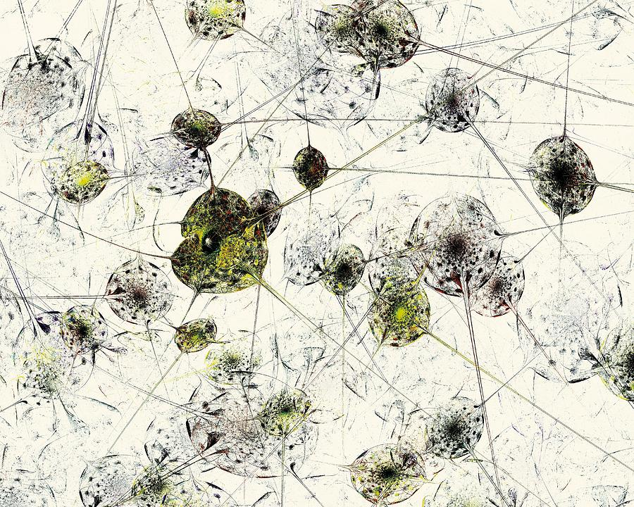
There are interactions everywhere in organisms,
even in simple cells.
A. Malakhova

Slide 19
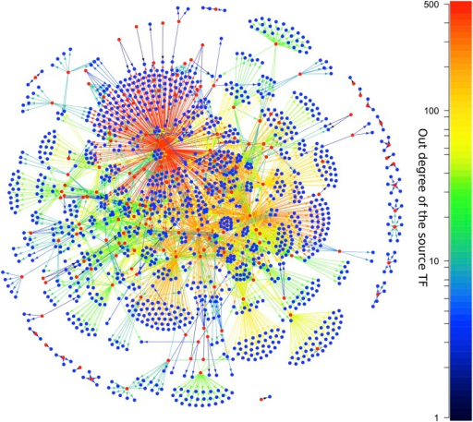
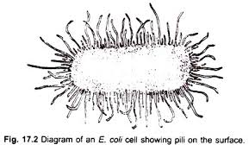
For instance, 2 representations of E. coli
left morphological; right: emerging from gene regulatory networks
Regulators Other genes

Slide 20



The architecture of these networks is informative.
A
B
Promoteur
Gène codant
C
Feed-forward loop
Promoteur
Gène codant
Promoteur
Gène codant
Certaines interactions entre molécules ont des conséquences prévisibles.
Manager, assistant et employé Certaines interactions entre molécules ont des conséquences prévisibles. C’est le cas de la boucle de préalimentation. Cette organisation implique 3 éléments : 3 gènes, un « manager », X ; un « manager assistant », Y ; et un « employé », Z.
La transmission de l’ordre du « manager » au « manager assistant » introduit donc un délai qui évite bien du gâchis quand l’employé a besoin d’une double autorité pour agir. Pourquoi dépenser de l’énergie pour produire un robot inutile38 ? Pour sa part, l’architecture par boucle de préalimentation “OU” permet d’accomplir d’autres fonctions, non moins avantageuses qu’une gestion parcimonieuse des ressources39. Les boucles de préalimentation “ET” et “OU” remplissent d’ailleurs des fonctions complémentaires :h la première permet à la cellule de ne pas se laisser troubler par la présence ponctuelle de signaux, la seconde permet à la cellule de ne pas se laisser troubler par l’absence ponctuelle de signaux.

Slide 21
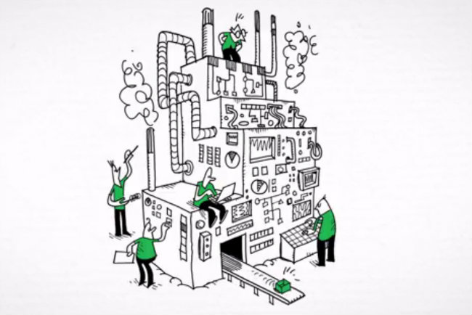
Le défi pour les évolutionnistes soucieux de ces découvertes, c’est d’établir comment toutes ces architectures se sont mises en place.
This introduces new biological questions: how did the architecture of such networks evolve?
A
B
C
time
A
B
C
A
B
C
Selection vs neutral evolution
Deux hypothèses se distinguent : ou bien l’architecture de l’ensemble du réseau est déterminante pour sa fonction et fait l’objet d’une sélection, ou bien ce type de réseaux « obèses » résulterait d’un mécanisme d’agrégation plutôt neutre, assemblant « par défaut » des blocs de réseaux déjà en place quand une nouvelle connexion entre un gène « manager » et un « gène employé » se crée46

Slide 22
Networks support different explanations than a tree:
Are there organizing principles for biological networks?

Slide 23
We are developing « phylosystemic » methods
dedicated to infer interaction network evolution.

Slide 24
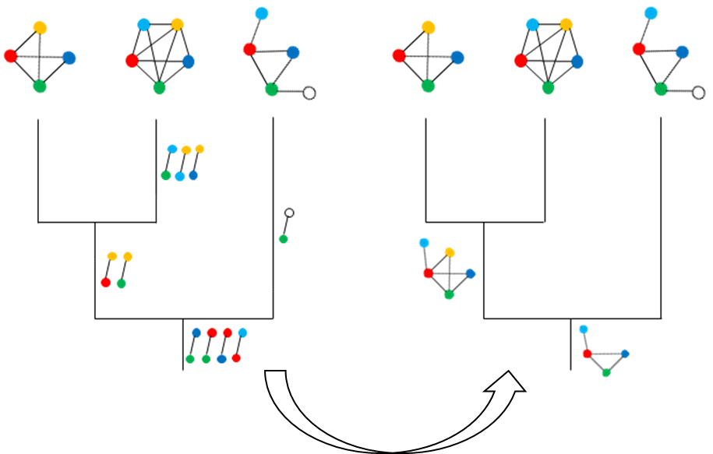
Principle of a ‘phylosystemic’/’evosystemic’ study.
Species A
Species B
Species C
Inputs:
Interaction networks
A reference phylogeny
Orthology relationships between nodes in networks.
Outputs:
Hypothetical ancestral networks
Interaction networks
Phylogenetic tree of species
Watson, A.K., Habib, M., Bapteste, E., 2020. Phylosystemics: Merging Phylogenomics, Systems Biology, and Ecology to Study Evolution. Trends Microbiol. 28, 176–190

Slide 25
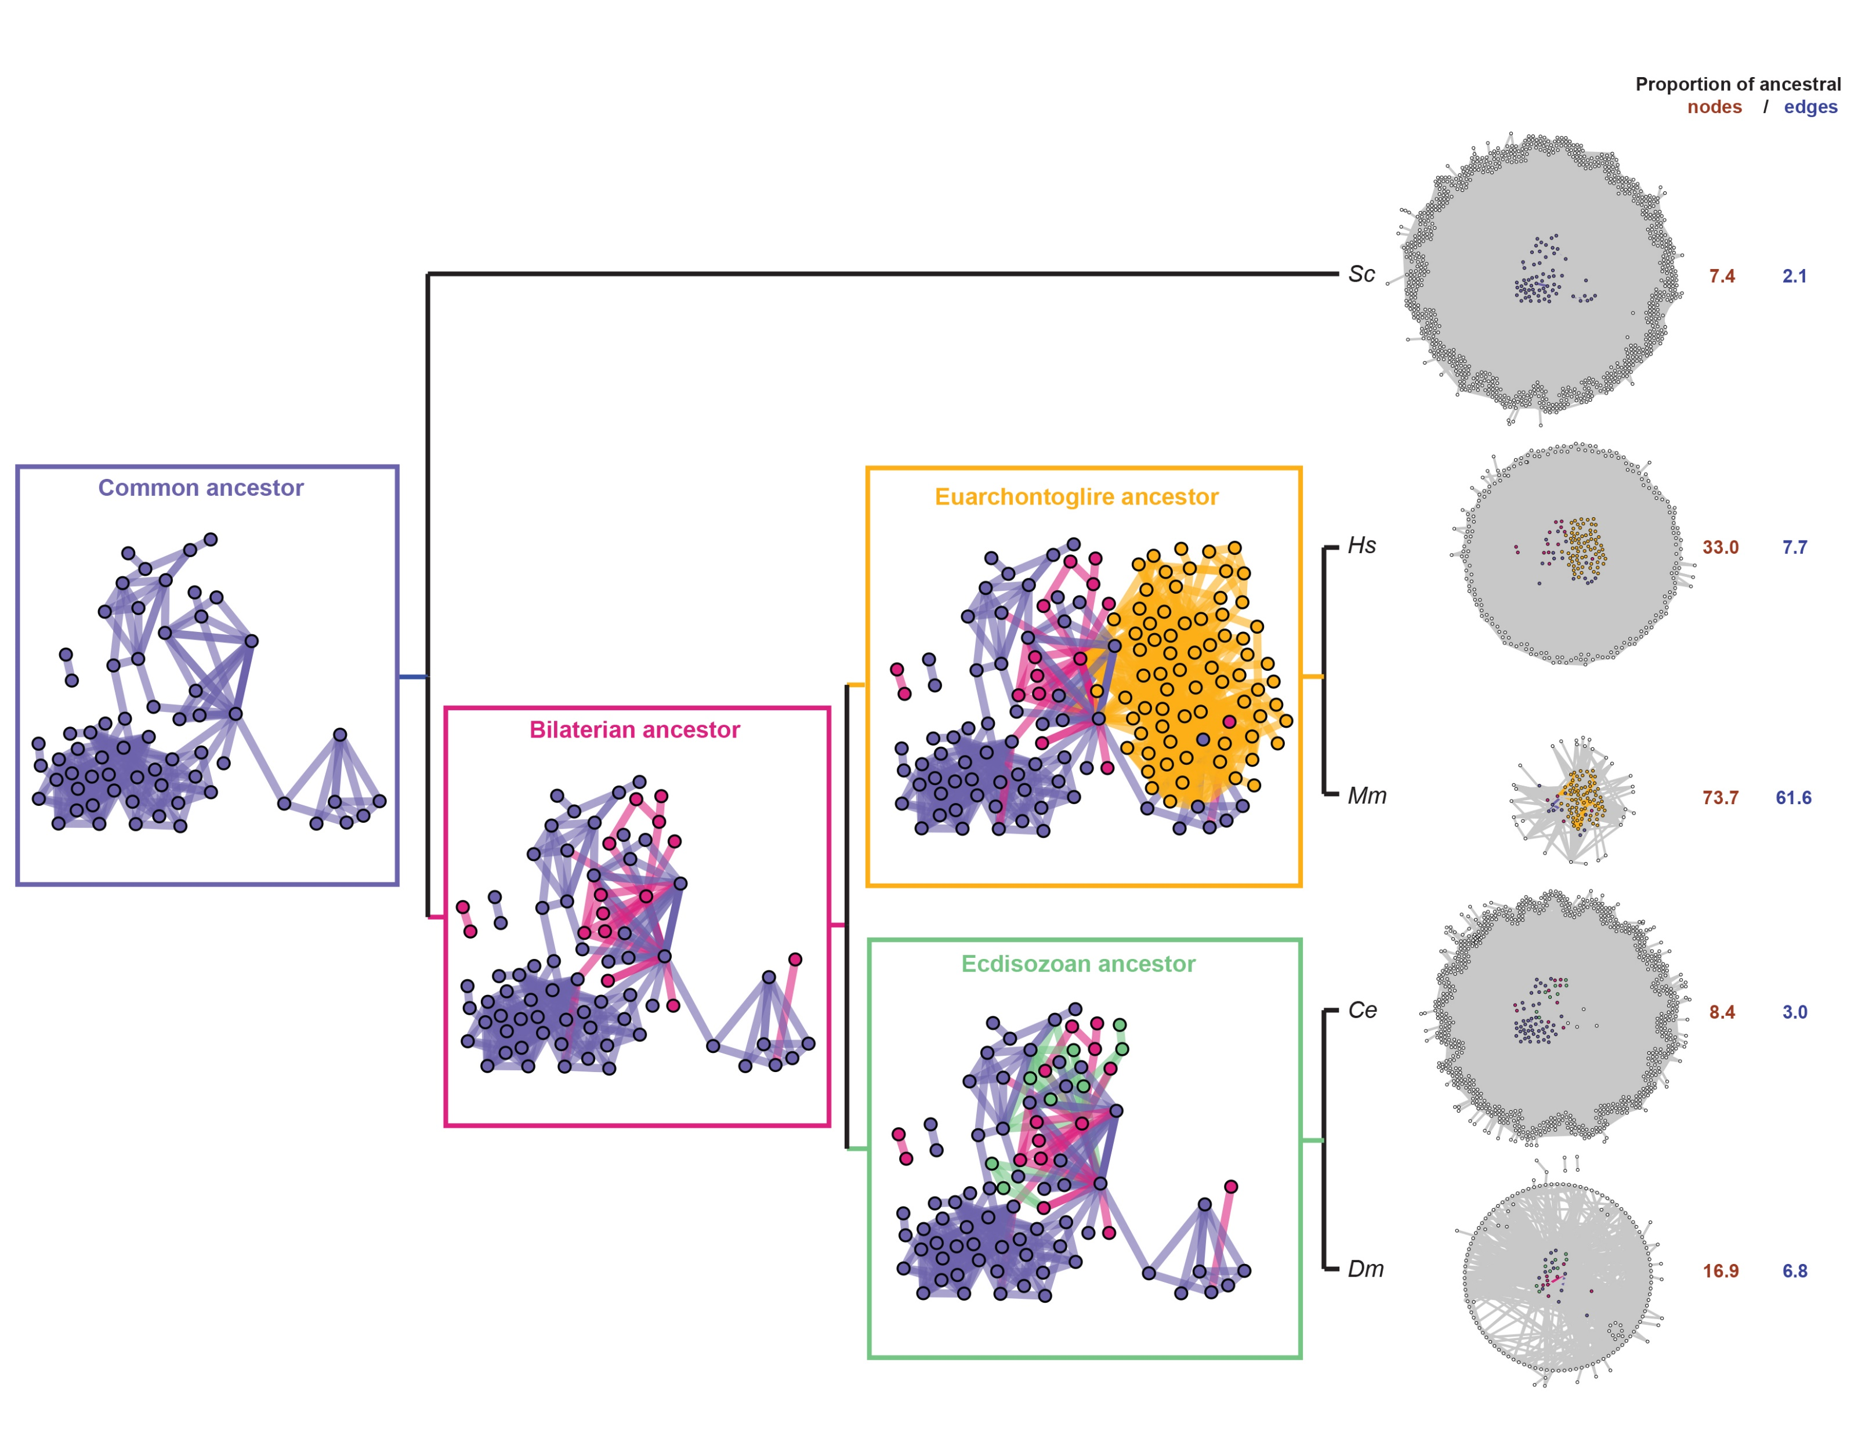






For instance, we inferred the evolution of protein interactions
associated with ageing
Teulière et al. GeroScience. 2022.
Extant networks
≈1,15 Gya
≈87 Mya
≈708 Mya
≈663 Mya
Ancestral Networks
Notes:
we used ancestral protein-interaction networks that included i) the ageing network of the last common ancestor of Bilateria (≈708 Mya), ii) the ageing network of the last common ancestor of Ecdisozoans (≈663 Mya) and iii) the ageing network of the last common ancestor of Euarchontoglires (≈87 Mya).
further classify all their edges into ‘interactions between old nodes’ (for edges involving two proteins older than the phylogenetic branch leading to the ancestor taxa under consideration); into ‘interactions involving a novel node’ (for edges involving at least one protein born along the phylogenetic branch leading to the ancestral taxa under consideration);
focused on the ‘novel interactions’ that evolved in the last common ancestor of Bilateria (≈708 Mya), ii) in the last common ancestor of Ecdisozoans (≈663 Mya) and iii) in the last common ancestor of Euarchontoglires (≈87 Mya) to quantify the contribution of ageing genes older than these time points, hence of possible cooptions, to these new interactions.

Slide 26
Organisms, even simple cells,
belong to networks.
A. Malakhova

Slide 27
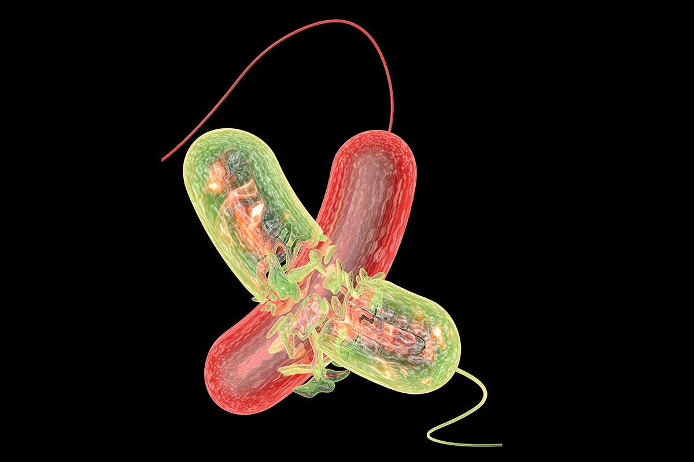
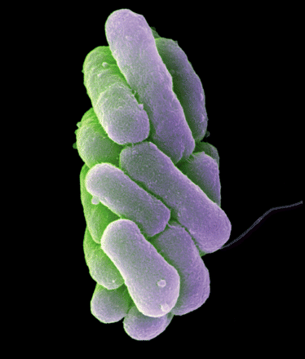
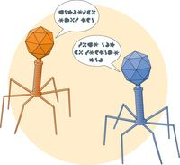
Microbes interact in many ways.
Competition
Cooperation
Communication
Alfred Pasieka/SPL
Wanner et al., J. Bact.(2008)
Erez et al., Nature
Notes:
And critically, not only microbes have been everywhere for billion years, but they have been pretty active too. Microbes have competed with each other, cooperated as teams, and communicated. And they still do all of this.
https://www.newscientist.com/article/2120273-vicious-microbial-warfare-helps-bacteria-evolve-cooperation/

Slide 28
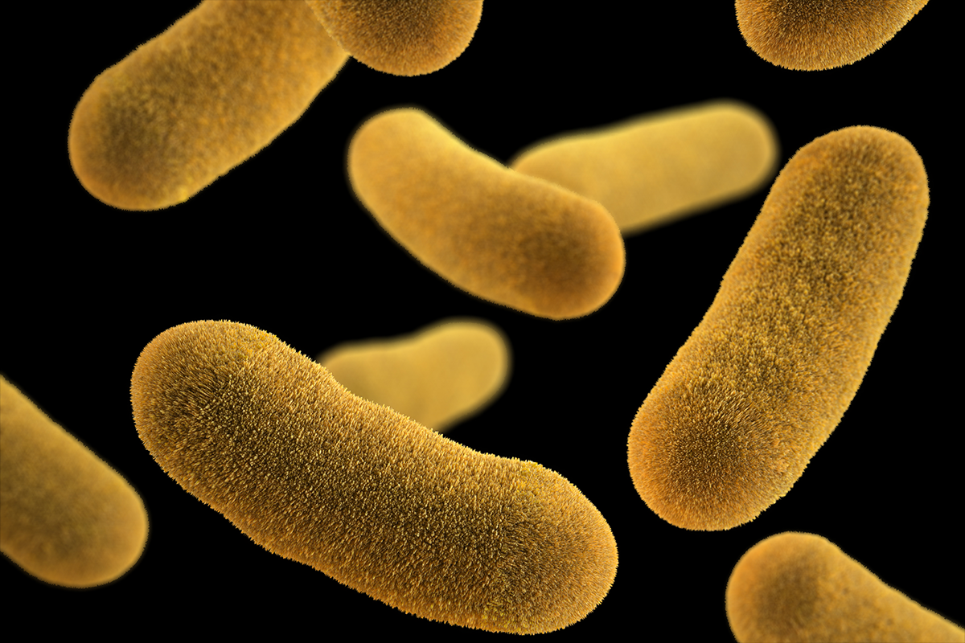
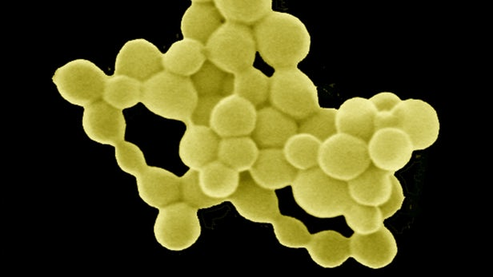

Some ultra-small microbes are involved in collective reactions by metabolic hand-offs
Nitrogen Fixation
in addition to resolving which
organism can do what (Figure 6A), it is possible to examine the distributions of traits over coexisting organisms within an
ecosystem (Anantharaman et al., 2016; Dombrowski et al.,
2017; Wrighton et al., 2014). The Anantharaman revealed evidence for extensive interconnection among the
metabolisms of coexisting community members. This ecosystem structure is counter to
the expectation that, for example, a single bacterium is responsible
for all steps in nitrate reduction. The phenomenon, involving
cooperative biogeochemical cycling, has been referred to as
‘‘metabolic handoffs’’ (Anantharaman et al., 2016; Hug et al.,
2015) and is diagrammed in Figure 6B. Through metabolic handoffs,
the ecosystem can adopt a large number of configurations
by shifting the mixture of organisms involved in a process as
environmental conditions change. Complex interdependencies,
and especially obligate symbioses, may explain why some organisms
are difficult to grow in pure cultures (as isolates).
Castelle et al. Cell 2018
Extensive interconnection among the metabolisms of coexisting community members. This ecosystem structure is counter to the expectation that, for example, a single bacterium is responsible for all steps in nitrate reduction.
Through metabolic handoffs, the ecosystem can adopt a large number of configurations by shifting the mixture of organisms involved in a process as environmental conditions change.
(B) Diagramillustrating the concept of coexisting microorganisms working together to complete a single biogeochemical pathway (ammonia, NH3, to N2). This is based on Figure 6 and traits data in Supplementary Table 9 of Anantharaman et al. (2016). Examples of coupling of reduction of nitrogen-based compounds to the iron, carbon, hydrogen, and sulfur cycles are included. The phenomena illustrated are referred to as ‘‘metabolic handoffs’’ because the product of one organismis made available to another organism with the capacity to use it. Importantly, Anantharaman et al. demonstrated that few organisms have the ability to generate energy from all of the steps in most pathways analyzed. Note that essentially all of the organisms studied are only distantly related to isolated organisms. For taxonomic affiliations, see Table S1.

Slide 29
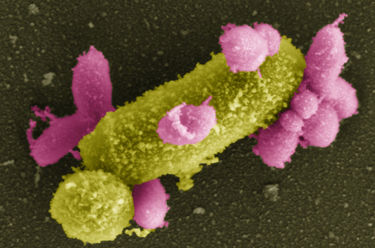
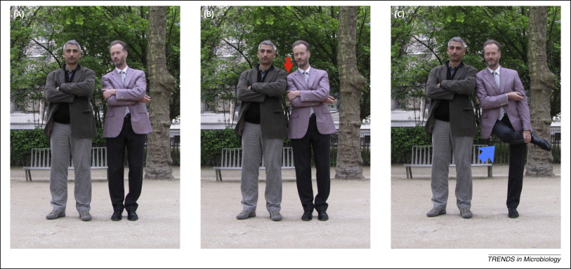
Un réseau explique l’évolution de ces cellules à ADN réduit, trop petites pour vivre seules.
Ultra-small cells would have lost some of their genes in the context of interactions with other organisms.
CPR
CPR
CPR
G
E
N
E
G
E
N
E
G
E
N
E
(Sélosse et al. Trends in Micro., 2014)

Slide 30
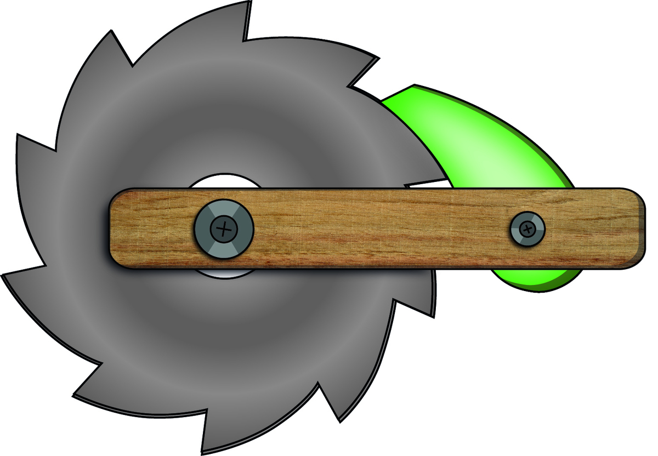
Such interactions lead to counter-intuitive predictions.
RATCHET
(Gray & Doolittle, Science, 2010)
PRE-SUPPRESSION
Such dependances are difficult to reverse, thus complex microbial communities, with non autonomous cells, are expected to evolve over time.

Slide 31
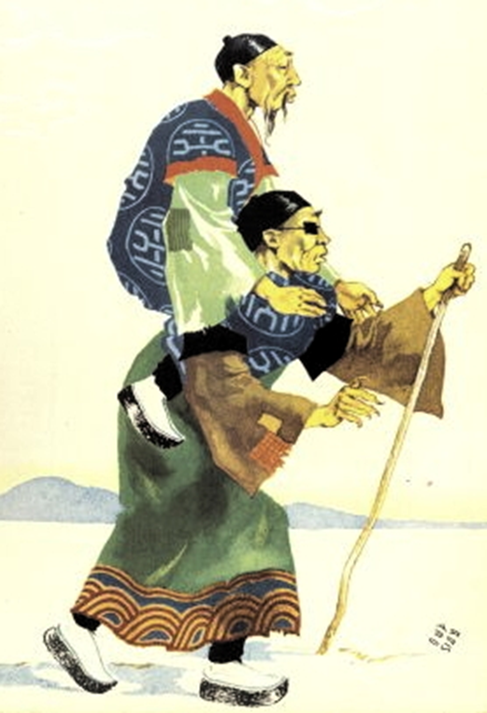

This kind of explanation contrasts with a more classic vision.
Survival of the fittest
(within a population/species)
Complementation (within a community)
On est loin de l’image d’un plus apte, triomphant seul dans la lutte pour la vie. Cette contingence est difficile à modéliser.

Slide 32
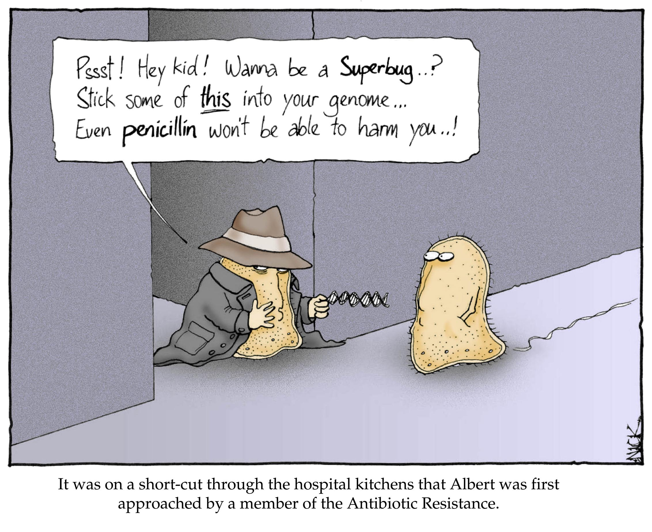
Other ex, horizontal gene transfer is a process by which an organism receives genes from a neighbor, rather than from an immediate ancestor.
DNA
http://www.lab-initio.com/sci_bio_genetics.html

Slide 33
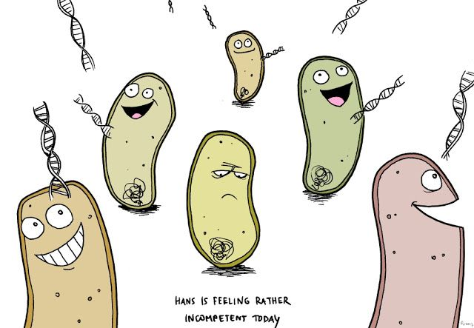
Gene sharing allows microbes to evolve very fast.
Melissa Patton
Notes:
D9 :This is important because a gene can encode a property, a trait
D10 :So exchanging a gene can change an organism.

Slide 34
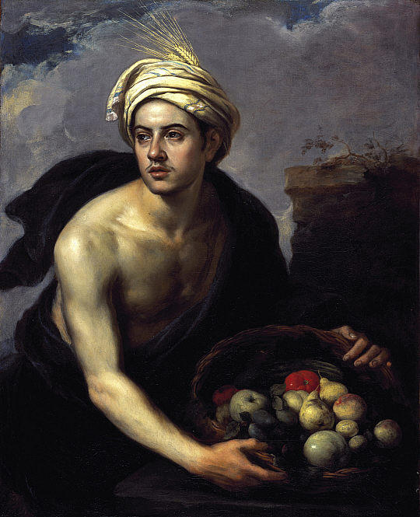

Horizontal transfer produces mosaic organisms.
un jeune homme avec un corbeille de fruits, 1640 de Bartolome Esteban Murillo

Slide 35
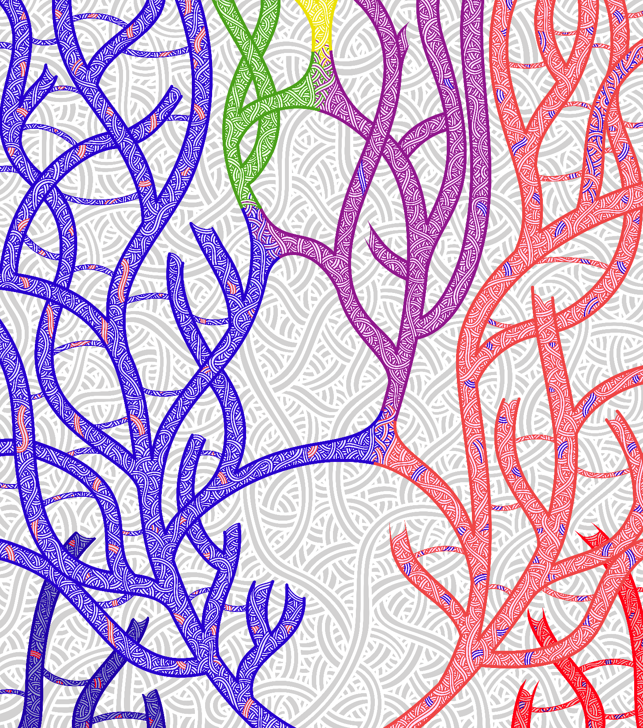
An extreme case : our origins, due to a symbiosis between Bacteria and Archaea that produced a new kind of cells.
Jordane Saget

Slide 36
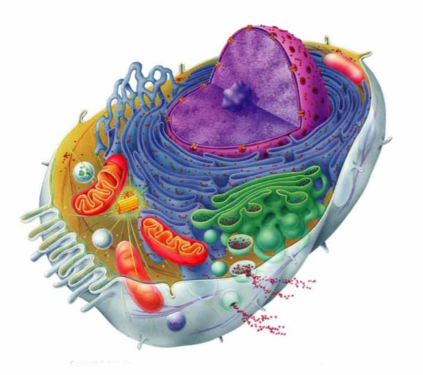
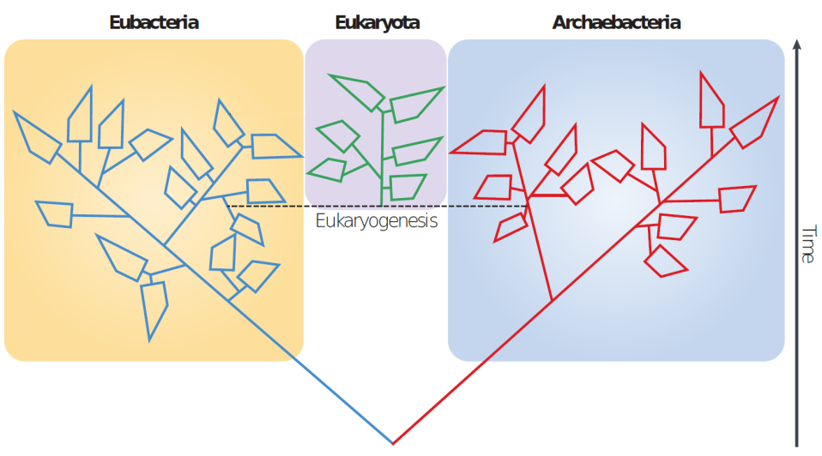
This dual origin contrasts with a classic evolutionary scenario.
Classic model
New model
EUKARYOTES
CHIMERA
CO-CONSTRUCTED
BACTERIA
NEW CELLS
ARCHAEA
1 ancestor
2 ancestors
J. Mc Inerney
Notes:
This discovery on our origins contrasts very much with classic evolutionary scenarios: in the classic model, species diverge from a single ancestor and form a tree of species; in the new model, 2 different ancestors merged inside a network to give birth to a new species. Yet, there is no doubt about this: we owe a lot to microbes. Our own body cell history started from a merger, a co-construction operated by 2 sorts of microbes, 2 billion years ago.

Slide 37
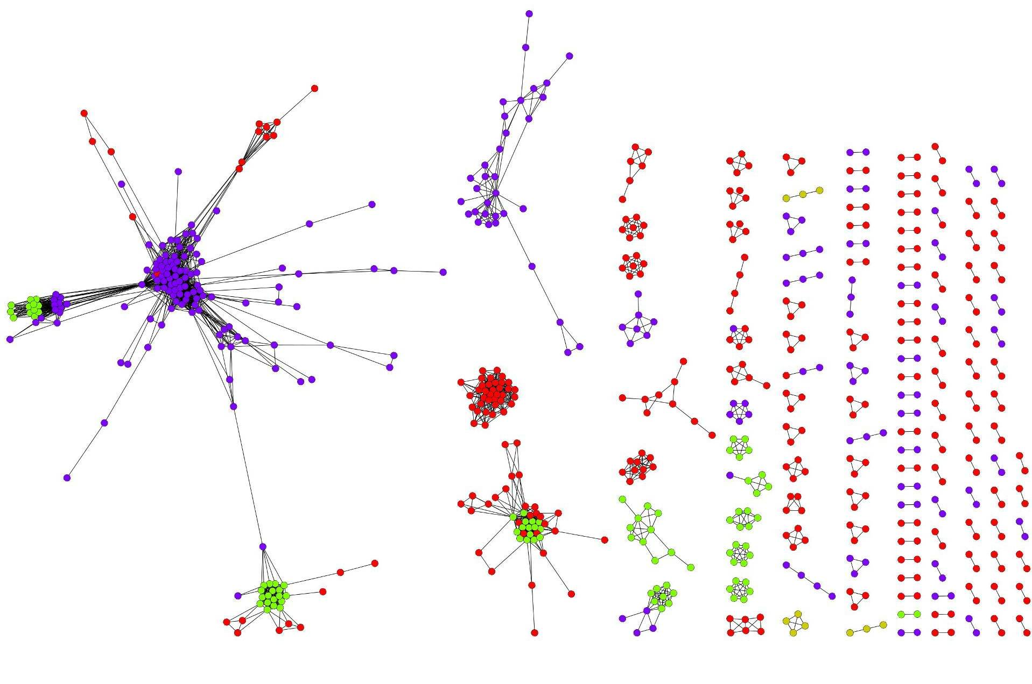
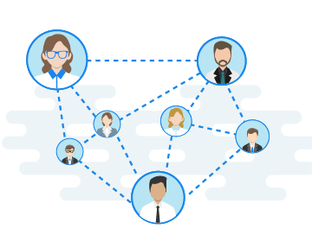
To retrace the multiple origins of such entities
requires an expanded formalism.
Halary et al. PNAS 2010

Slide 38
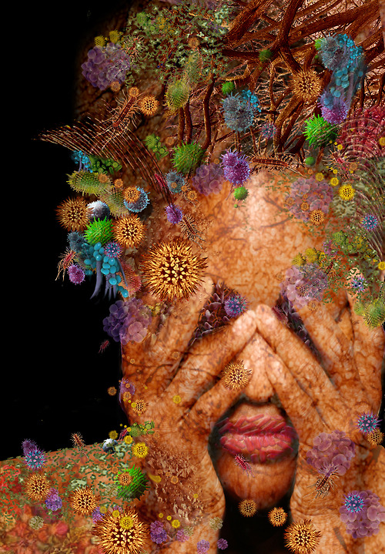
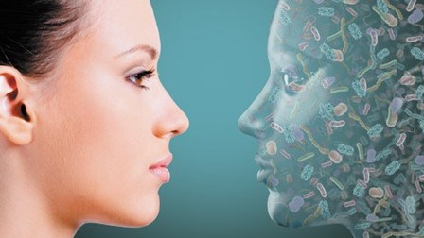
Moreover, our human cells (eukaryotes) do not live alone.
Notes:
Now, let’s make a big jump in time, getting closer to our future. Microbiologists have also come up with a very different discovery: our body cells do not live alone. They are surrounded by contemporary microbes which inhabit our body, as they live on our skin, in our guts, etc.

Slide 39
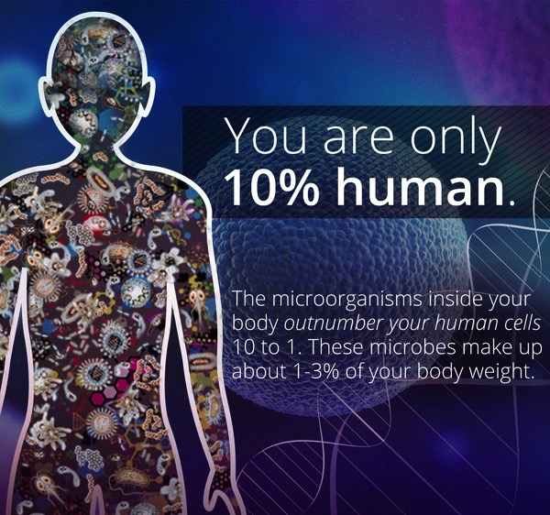


Balance
The impact of extant microbes on human biology is thus re-evaluated.
5
47
Human genes
Microbiome
150 X
Notes:
Overall, your body hosts the same number of human and microbial cells. However, the number of genetic instructions carried by your microbes is 150 times larger than the number of genetic instructions carried by your human cells. This finding may have profound impact on the understanding of the human biology, and how our species could change.

Slide 40
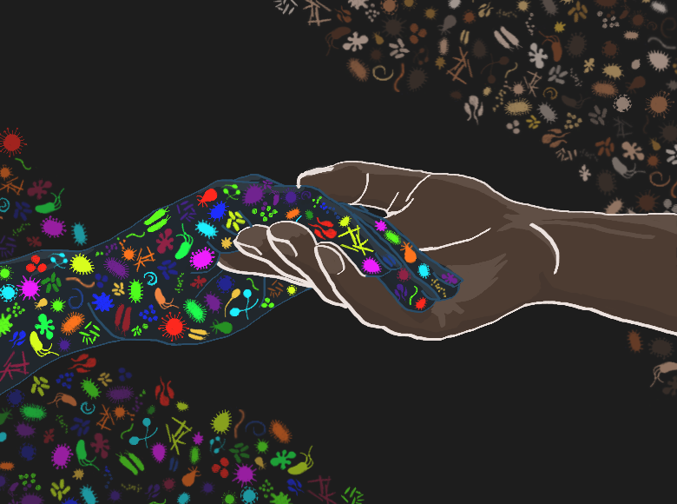
Not only do our microbes interact together,
but they also interact with our cells.
Scott F Gilbert
Notes:
Indeed, the microbes inhabiting us do not only interact together: some of them can also interact with our human cells.

Slide 41
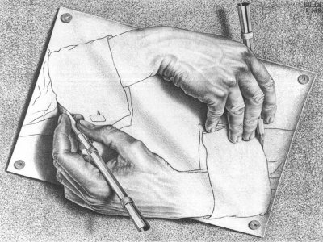
Chosmo sapiens, jointly human and microbial ?
Microbes have co-constructed our species– and they still do it.
Microbes
Humans
Notes:
So far, I have said that we owe a lot to microbes: they built our basic cells, and they interact with our body. This last point is another revolution. Some of our traits, that we sought of as typically humans, possibly come from interactions with our microbial partner. Who we are comes in part from outside our lineage. In other words: we are both microbes and human.

Slide 42
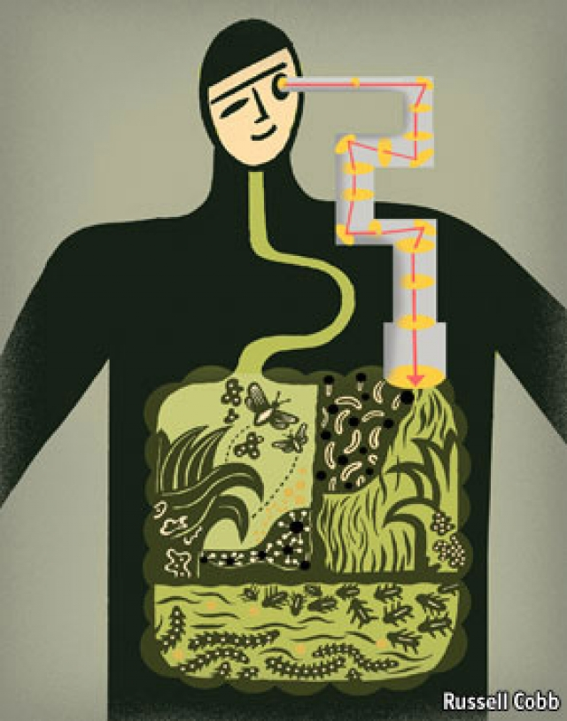
Homo sapiens is discovering Chosmo sapiens.
Co-constructed traits
Human traits
Microbial traits
Chosmo sapiens
Notes:
Here, microbiology studies is in the process of unraveling a fundamental complexity of our human nature: we are co-constructed. Each of us is not merely human. We are all associations of a cosmos of microbes with our own body. I call this association Chosmo sapiens to highlight the intertwining of our human and microbial components.

Slide 43
The extent of this co-construction is under study.
Co-constructed traits
Co-constructed traits
…
Vascularization, bones, digestion, immunity, obesity, behavior…
Notes:
Scientists are now starting to investigate what traits might be influenced not only by our human DNA, but also by our interactions with microbes. This is a very debated area of research. But the literature suggests that our microbes could impact a diversity of our traits: from the development of our bones, blood vessels, of our immune system, of our body weight, of our digestion, and possibly to some extent of our behavior. It remains to be determined, over a life time, what proportion of our traits are co-constructed by microbes. If this co-construction is massive as shown to the right, we will have to learn again a lot about human biology. Yet, I bet that it would be much worse for your health to loose all your microbes than to loose your hand or your feet.

Slide 44
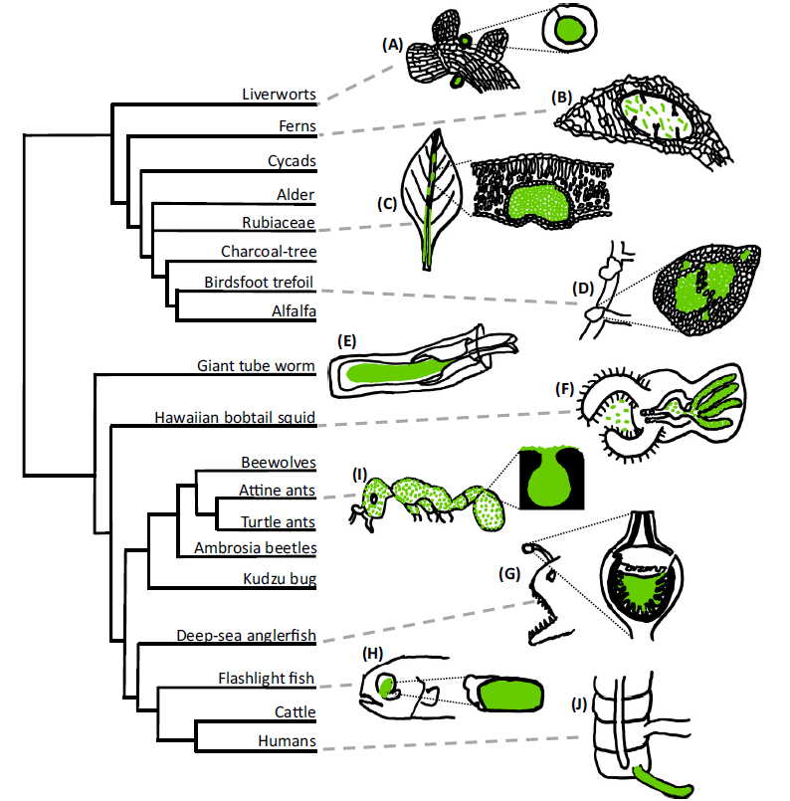
Functions of « symbiotic organs» are described in an increasingly large number of animals and plants…
This conclusion holds for very many other species…
NITROGEN FIXATION
TOXIN ANTI-ENNEMIS
Figure 1. Symbiotic organs in plants and animals. Host tissues are indicated in black and symbionts are indicated in green. In plants, organs have evolved that house
diverse bacteria, including: (A) auricles in liverworts and (B) leaf cavities in the waterfern Azolla, both of which fix nitrogen; (C) leaf nodules in Bwanashupa (Psychotria kirkii),
which produce toxins against competitors and predators; and (D) determinate root nodules in legumes, which also fix nitrogen. In animals, a more diverse set of services
has been uncovered including: (E) the trophosome in tubeworms, which houses carbon-fixing bacteria; light organs with bioluminescent bacteria in (F) squids,
(G) anglerfish, and (H) flashlight fish; (I) exoskeletal crypts in ants that house antibiotic-producing bacteria; and (J) the cecal appendix in humans. Adapted from [6] (A),
[92] (B), [43] (C), [46] (E), [23] (F), [28] (G), [22] (H), and [9] (I).
NITROGEN FIXATION
CARBON FIXATION
BIOLUMINESCENCE
ANTIBIOTICS
PRODUCTION
BIOLUMINESCENCE
Symbiotic organs: the nexus of
host–microbe evolution Trends in Ecology & Evolution, Month 2022, Vol. xx, No. xx https://doi.org/10.1016/j.tree.2022.02.014 1
David C. Fronk1 and Joel L. Sachs
Fronk &.Sachs, Trends in Ecology & Evolution, 2022
MICROBIAL BANK
Notes:
Une conclusion selon moi finira par s’imposer: il va falloir étendre le cadre théorique pour penser l’évolution en reconnaissant la part des interactions entre espèces
Les fonctions d’« organes symbiotiques » sont décrits chez un nombre croissant d’animaux et de plantes.
Il s’agit de structures d’accueil pour microbes, souvent co-construites par les deux partenaires. Elles servent à stabiliser des symbioses bénéfiques.

Slide 45
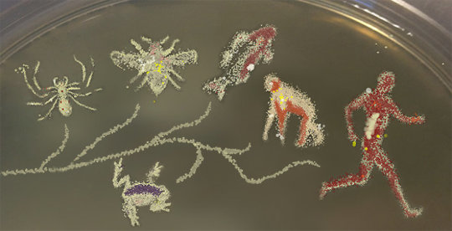
Aux origines des traits: des animaux & plantes co-construits?
On the origins of traits: animals & plants as co-constructions?
Problem: a classic tree of the mere hosts lineages does not describe the processes responsible for co-constructed traits.

Slide 46
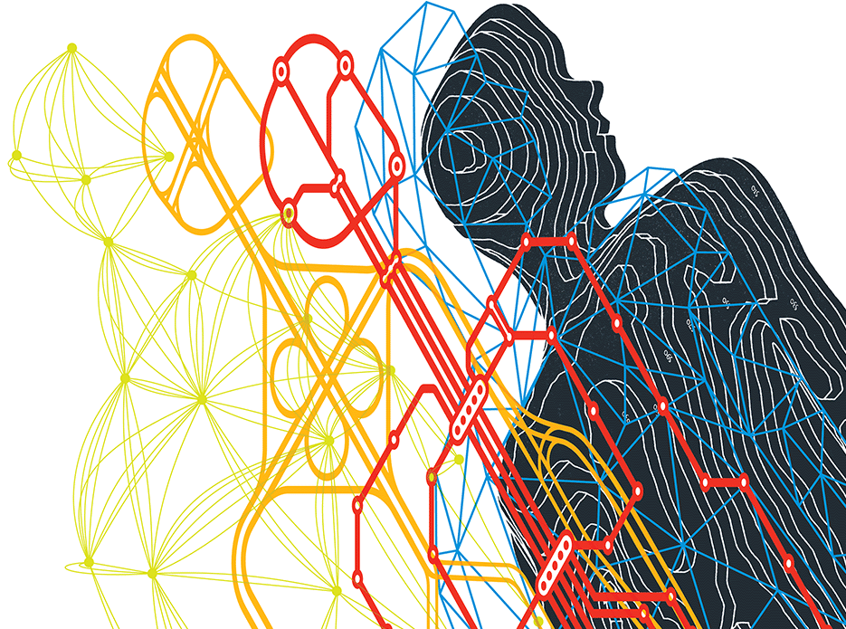
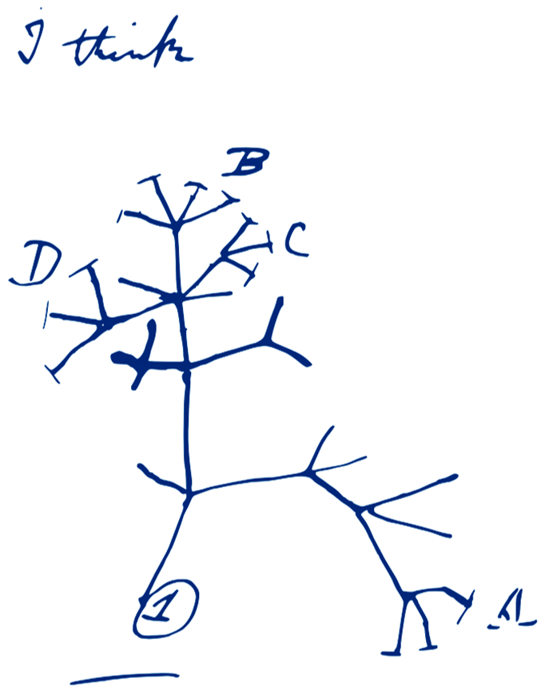


To sum up, evolution has produced complex organisations
Multi-agents
Multi-lineages
Multi-level
Nested
Interconnected
An enhanced evolutionary biology seems warranted.
Notes:
All the above suggests that evolution is more complex than vertical descent and cannot be fully described using only a tree model.s

Slide 47
Even the model of evolution by natural selection can be further generalized.
(Doolittle & Inkpen, PNAS 2018)

Slide 48
Even the model of evolution by natural selection can be further generalized.
Units of selection
Variation:
not all entities to consider as evolving are identical.
Differential fitness:
different traits can confer survival or reproductive advantage.
Inheritance:
Variation can be, in part, reproduced.

Slide 49
Even the model of evolution by natural selection can be further generalized.
A2
B3
There are variation in the population of interactions:
not all entities to consider as evolving are identical.
C
A1
B1
Some interactions show differential fitness:
different patterns display survival or re-productive advantage.
C
A1
D
Inheritance:
Some interactions can be re-produced
F
Z
P
Candidate units of selection
(Doolittle & Inkpen, PNAS 2018)
C

Slide 50
Some interactions with such properties will have their frequency change; or their robustnesss/resilience change wrt others and therefore may be seen under that more general framework as units of selection.
A2
B3
There are variation in the population of interactions:
not all entities to consider as evolving are identical.
C
A1
B1
Some interactions show differential fitness:
different patterns display survival or re-productive advantage.
C
A1
D
Inheritance:
Some interactions can be re-produced
F
Z
P
(Doolittle & Inkpen, PNAS 2018)
C
Notes:
In blue, the winning pattern: its nodess become more abundant than others in the initial populations

Slide 51
Interestingly, these units of selection may not correspond to traditional lineages: they can also form functional units that occur again and again or change/evolve.
A2
B3
There are variation in the population of interactions:
not all entities to consider as evolving are identical.
C
A1
B1
Some interactions show differential fitness:
different patterns display survival or reproductive advantage.
C
A1
D
Inheritance:
Some interactions can be re-produced
F
Z
P
(Doolittle & Inkpen, PNAS 2018)
C

Slide 52
The bottom line is that
« partners mutate, interaction pattern change and dependencies/interdependencies can evolve».
C
C
j
k
j
i
i
i
A1
B1
A1
B1
A1
B1
C
The bottom line is that
« genes mutate, organism change and population or species evolve».

Slide 53





Variable taxa but conserved functions in the human gut microbiome
This situation typically occurs within host-associated microbiomes.
Foster et al. Nature 2017
Turnbaugh et al. Nature 2009; Dinsdale et al. Nature, 2008; Doolittle & Zhaxybayeva, Bioscience, 2010 ; Yachi & Loreau, PNAS 1999
The song, not the singer
Interactions can get selected and evolve. This departs from a classic organismal-centered perspective on evolution.
Notes:
Let me give you an example of a functional group: the genes are not all coming from the same donors, they do not form lieanges of genes, yet various combinations of genes from different parental host can still be selected as these associations achieve a particular function that enhances the potential of the underlying interactions to be re-produced.

Slide 54


More generally, it can be used to investigate the evolution of processes sustaining Life.
Davide Bonadonna.
Explaining the evolution of organisations, typically that of ecosystems, is a broader issue than infering relatedness between species.
Notes:
At the same time we realize our profound microbial nature, evolutionary studies expands. They now use both trees and networks, which describe different aspects of life and of its evolution. 160 years ago, Darwin started a quest to understand the origins and evolution of species with a tree of species; nowadays, evolutionary biologists try to understand the origins and evolution of entire ecosystems with networks of interaction. Indeed, it is good but not sufficient to know what dinosaurs were cousins to what other dinosaurs to understand how the diversity on Earth shifts over time. To understand how we went from this ecosystem to that ecosystem, we also need to know about the network of interactions between species and their environments.

Slide 55

Possible schematics for the evolution of the A,B,C,D,E,F song.
Network comparisons could highlight interactions that may be under some form of selection*
B
B
B
A
A
A
t
* e.g., increase in strength and relative abundance in the system

Slide 56
Possible schematics for the evolution of the A,B,C,D,E,F song.
Network comparison could unravel interactions with critical structural roles, possibly as a result of selection.
One could check if some interactions within a system appears robust
B
B
B
A
D
A
D
A
D
C
C
C
t
* e.g., occur at consecutive time points – and for how long

Slide 57

Possible schematics for the evolution of the A,B,C,D,E,F song.
Network analyses could report architectures that may be the result of selection.
One could check if if a system displays modules of robust* interactions
Network at t
* e.g., tight clusters of robust edges

Slide 58
Possible schematics for the evolution of the A,B,C,D,E,F song.
Network analyses could show whether and how the persistence
– hence the fitness- of an ecosystem changes.
One could check if if a system robustness and its modularity* increases
Network at t
* e.g., tight clusters of robust edges

Slide 59
Possible schematics for the evolution of the A,B,C,D,E,F song.
Network comparison could unravel interactions with critical structural roles, possibly as a result of selection.
One could check if some interactions within a system appears resilient*
B
B
B
A
D
A
D
A
D
C
C
C
t
* e.g., occur at disjoint time points – and for how long

Slide 60
Possible schematics for the evolution of the A,B,C,D,E,F song.
Network analyses could report architectures that may be the result of selection.
One could check if if a system increasingly displays modules of resilient* interactions.
Network at t
* e.g., tight clusters of resilient edges

Slide 61





Possible schematics for the evolution of the A,B,C,D,E,F song.
If network analyses show whether and how the persistence
– hence the fitness- of an ecosystem changes, then simple metrics may capture tipping points in the evolution of these ecosystems.
T1
T2
T3
T4
T5
T6
TIME
e.g. experiencing phase transition due to time or some human action….

Slide 62




« It is the song, not the singers » (Doolittle & Inkpen, PNAS 2018)
A
1
2
A
1
2
F
B
ITSNTS
F
B
6
3
6
3
E
C
E
C
5
D
4
7
D
4
Original song: ABCDEF
Original singers: 1,2,3,4,5,6
Re-produced song: ABCDEF
Different singers: 1,2,3,4,7,6
Interaction patterns as new objects of study for evolutionary biology
Notes:
This has been further generalized to consider not only patterns of interactions between given nodes that increase in frequency but also patterns of interactions involving given kinds of edges.s

Slide 63

Possible schematics for the evolution of the A,B,C,D,E,F song.
*If the new song increases in frequency wrt ABCDEF, in some environments, then the new song can be positively selected for.
Anytime, new song get selected because a singer changed the song, niche construction occurred.
Modeling interaction networks opens up new research avenues for evolutionary biology.
Notes:
And is further discussed here for those who care.s

Slide 64

Conclusion
Classic model do not focus interactions and on the evolution of interactions
A more inclusive framework could be useful to better understand the stability of the living world while accounting for dependences/interdependences.
Enhanced evolutionary biology studies could contribute to this at multiple scales.
Evolutionary biology may also have something to say about the future history and diversity of life.
Notes:
Classic model do not focus interactions and on the evolution of interactions
A contemporary evolution theory proposes to explain such phenomena
Invisible, if one does not consider interactions between individuals,
Ubiquitous, if one considers these interactions.

Slide 65


These two evolutionary perspectives are very different:
trees focus on relatedness, networks focus on organisation.
So, we could adopt 2 different evolutionary perspectives :
Trees focus on relatedness, networks on organization.
1 human
1 microbe
Co-construction
Microbes: too distants to really matter
Some microbes: very close and important
Notes:
This is very important, because thinking about the position of our species in a tree shows that we are very distant from microbes. Microbes are far away from our species in the species tree. They are nothing like us. They do not think, suffer, behave in ways that resemble our human ways. And for this reason, because we are so different, in our policies and ethical considerations, we are prone to forget our too distant cousins. When thinking in terms of network however, we realize that some microbes can be very close to us: without them, we would not feel, think and suffer the way we do. In terms of networks, some microbes definitely matter, irrespective of how distant we are in genealogical terms.

Slide 66
What aspects of our biology are co-constructed, or worse manipulated by interspecific interactions, that we should not ignore for our own good?
???
Notes:
Mais pour faire un retour très nombriliste, au-delà de ces développements théoriques abstraits,
Il me semble qu’il y en a un et c est notre vieillissement

Slide 67
Component of a network, our future shall look like our past.
Contingent
Chimeric
Evolvable
Intertwinned
Notre avenir pourrait passer de nouvelles associations.
Notes:
To conclude, the future of our species could resemble its past. Our species is chimeric, owes a lot to microbes and is part of a network. For these reasons, our future could very well also be contingent, evolvable, and depends on what ties we will pull, create or destroy between our species and the rest of the network of life.

Slide 68
Most plants and animals are likewise connected:
our own species should act responsibly.
Technologies:
Scientists, biohackers, bioartists…
New interactions
Human interactions
Microbial
interactions
Co-constructed
interactions
Andrew Rae
Notes:
However, in as much as we could be technologically creative with our microbial partners, we should remember that it is not only our species that is part of this big interaction network: our microbes also interact with the microbes co-constructing the other species of animals and of plants. So, most importantly, we should be responsible if we start transforming our microbes, and the network of life.

Slide 69





Thanks a lot for your attention.
materiologiques.com/
And thanks to all my wonderful colleagues: Phil Lopez, Ed Corel, François Papale, Jordane Saget, Philippe Huneman, Andrew Watson, Ford Doolittle, Frédéric Bouchard, Debashish Bhattacharya, J. Teulière, François-Joseph Lapointe, …

